Slide 1

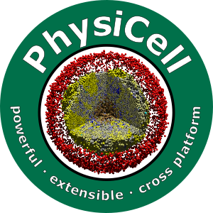

Session 0: Introduction to Agent-Based Modeling and PhysiCell
Slides, videos, links and more:
https://github.com/physicell-training/ws2021
Paul Macklin, Ph.D.
@MathCancer
July 15, 2021

Slide 2
Goals
Learn the concepts of agent-based modeling
Briefly survey the main types of agent-based modeling approaches
Learn about PhysiCell's agent modeling approaches
See some examples

Slide 3
Simple single-cell behaviors …
Growth
Division
Death
Adhesion
Mechanics
Motility
Secretion
Uptake
Sampling
Predation
Differentiation
…

Slide 4
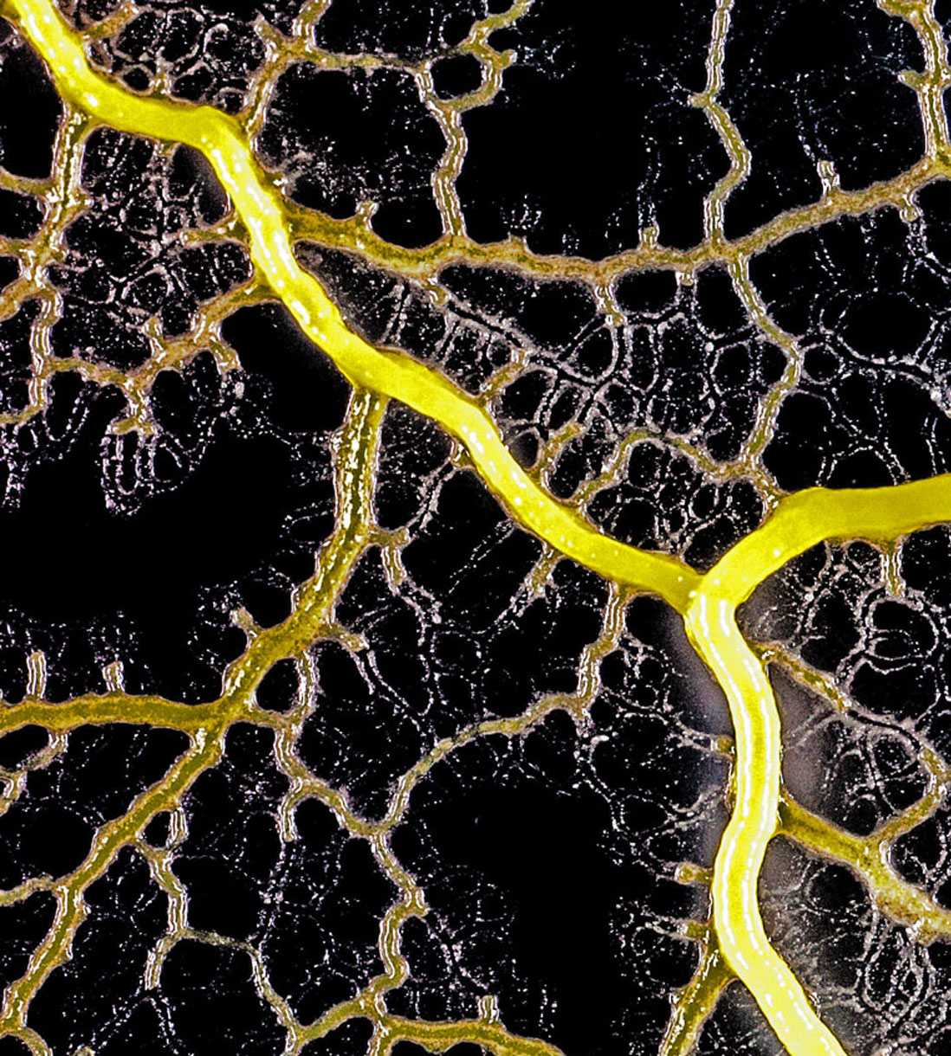
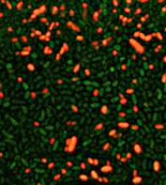
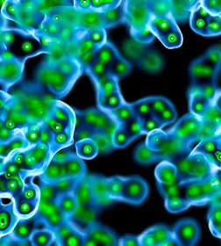
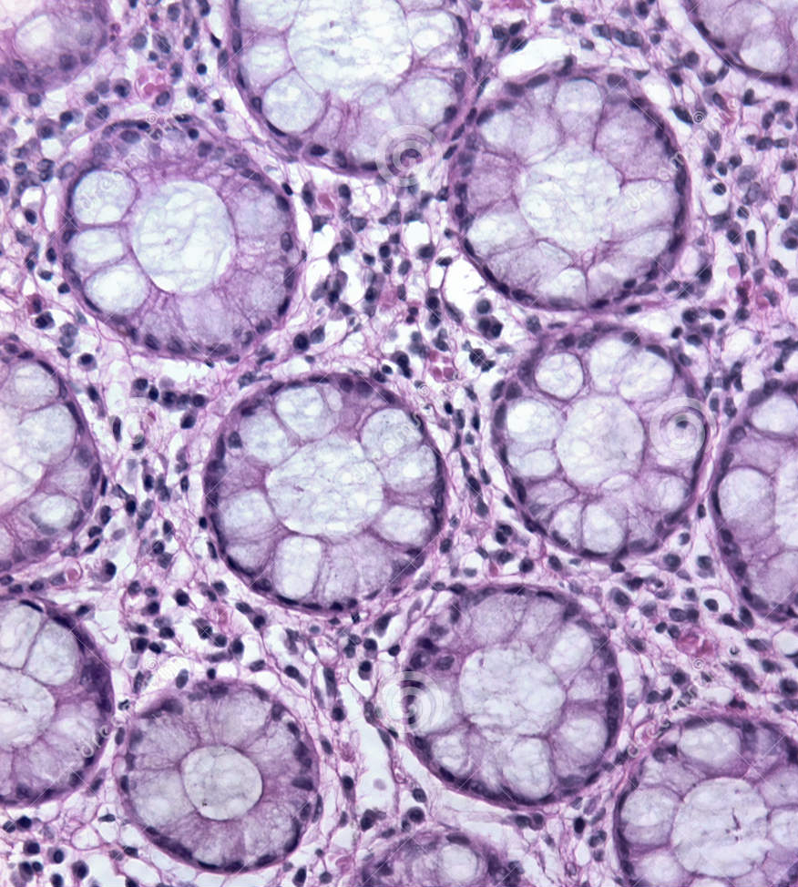
Give rise to complex systems
Multicellular systems—composed of multiple cells of multiple types—can exhibit remarkable diversity, with complex emergent behaviors.
How do these systems self-organize and sustain themselves?

Slide 5
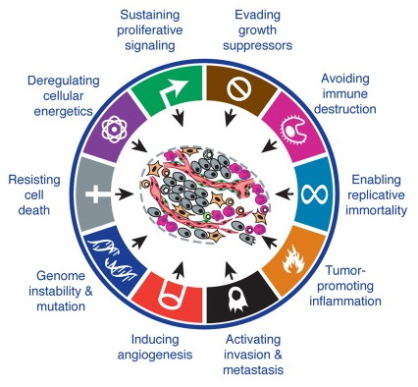
How do we understand these multiscale systems?
Interconnected systems and processes:
Single-cell behaviors
Cell-cell communication
Physics-imposed constraints (e.g., diffusion)
Systems of systems (e.g., immune system)
In diseases, these systems become dysregulated.
Treatments target parts of these systems.
Health is a complex system: changing one part can have surprising effects!
Modeling can help understand this system. This is multicellular systems biology.
If we can control these systems, we've arrived at multicellular systems engineering.
Source: Hanahan & Weinberg (2011)
DOI: 10.1016/j.cell.2011.02.013
Notes:
Tissues, including cancer, are complex, self-organizing systems.
Cancer is a complex system – treatments perturb this complex system, results can be surprising
Classic example: anti-angiogenic therapy
Mechanistic simulations can help us get new insights

Slide 6
Analogy: multicellular biology as a play
The microenvironment is the stage.
The cells are the actors.
The cell actors follow their own scripts.
BUT:
The scripts change based on the stage. (microenvironment-dependent phenotype)
The actors’ dialog is critical. (cell-cell communication)
The actors can tear up and remodel the stage. (tissue remodeling)
The actors can ignore their scripts and ad lib. (Mutations, evolution)
It’s our job as scientists to figure out each actor’s script by watching the play.
Clinicians and engineers want to rewrite the script.

Slide 7
Agent-based modeling is a modeling paradigm for these complex multicellular systems:
Cells are software agents that move and live a virtual tissue environment.

Slide 8
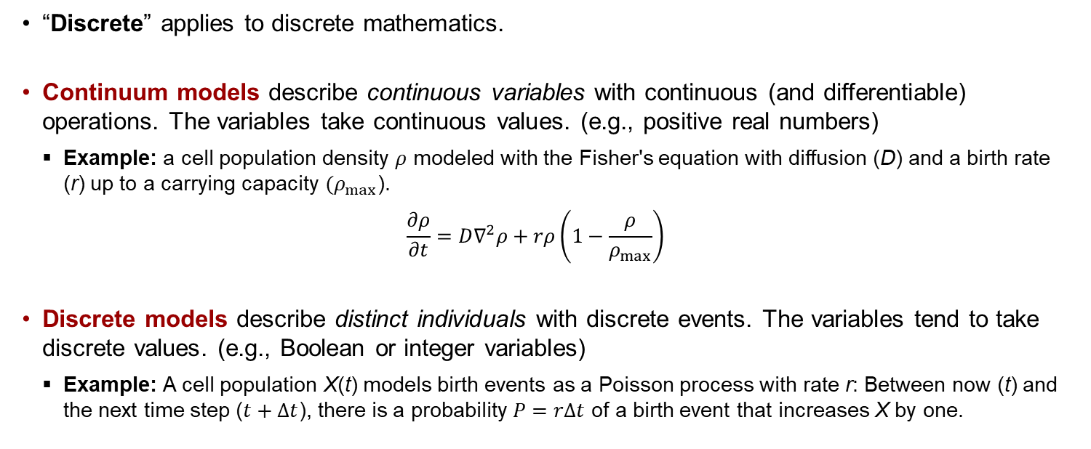
What is a discrete model?
“Discrete” applies to discrete mathematics.
Continuum models describe continuous variables with continuous (and differentiable) operations. The variables take continuous values. (e.g., positive real numbers)
Example: a cell population density $ρ$ modeled with the Fisher's equation with diffusion (D) and a birth rate (r) up to a carrying capacity $(ρ_{max}$).
$$\frac{∂ρ}{∂t}=D∇^{2}ρ+rρ\left(1−\frac{ρ}{ρ_{max}}\right)$$
Discrete models describe distinct individuals with discrete events. The variables tend to take discrete values. (e.g., Boolean or integer variables)
Example: A cell population X(t) models birth events as a Poisson process with rate r: Between now (t) and the next time step ($t+Δt$), there is a probability $P=rΔt$ of a birth event that increases X by one.

Slide 9
What is an agent-based model?
An agent-based model (in biology) is a type of discrete model that simulates individual cells.
Also referred to as individual-based models or cell-based models.
Agent-based models are often combined with continuum models of the microenvironment (e.g., partial differential equations for signaling factors), resulting in hybrid discrete-continuum (HDC) models.
Object-oriented programming (OOP) is ideal for agent-based modeling:
Modeling work focuses on individual cells
Each cell is an independent agent that carries its own data, and has its own behavioral rules
Use OOP: Define a cell class with member data and methods. Each cell is an instance of that class.
Agent-based models are a little closer to the biology:
Focus on modeling cells and their changing behavior.
Specific problems are then a matter of choosing the right rules.
You can tailor the level of detail: add molecular-scale biology to each cell if you need it.

Slide 10
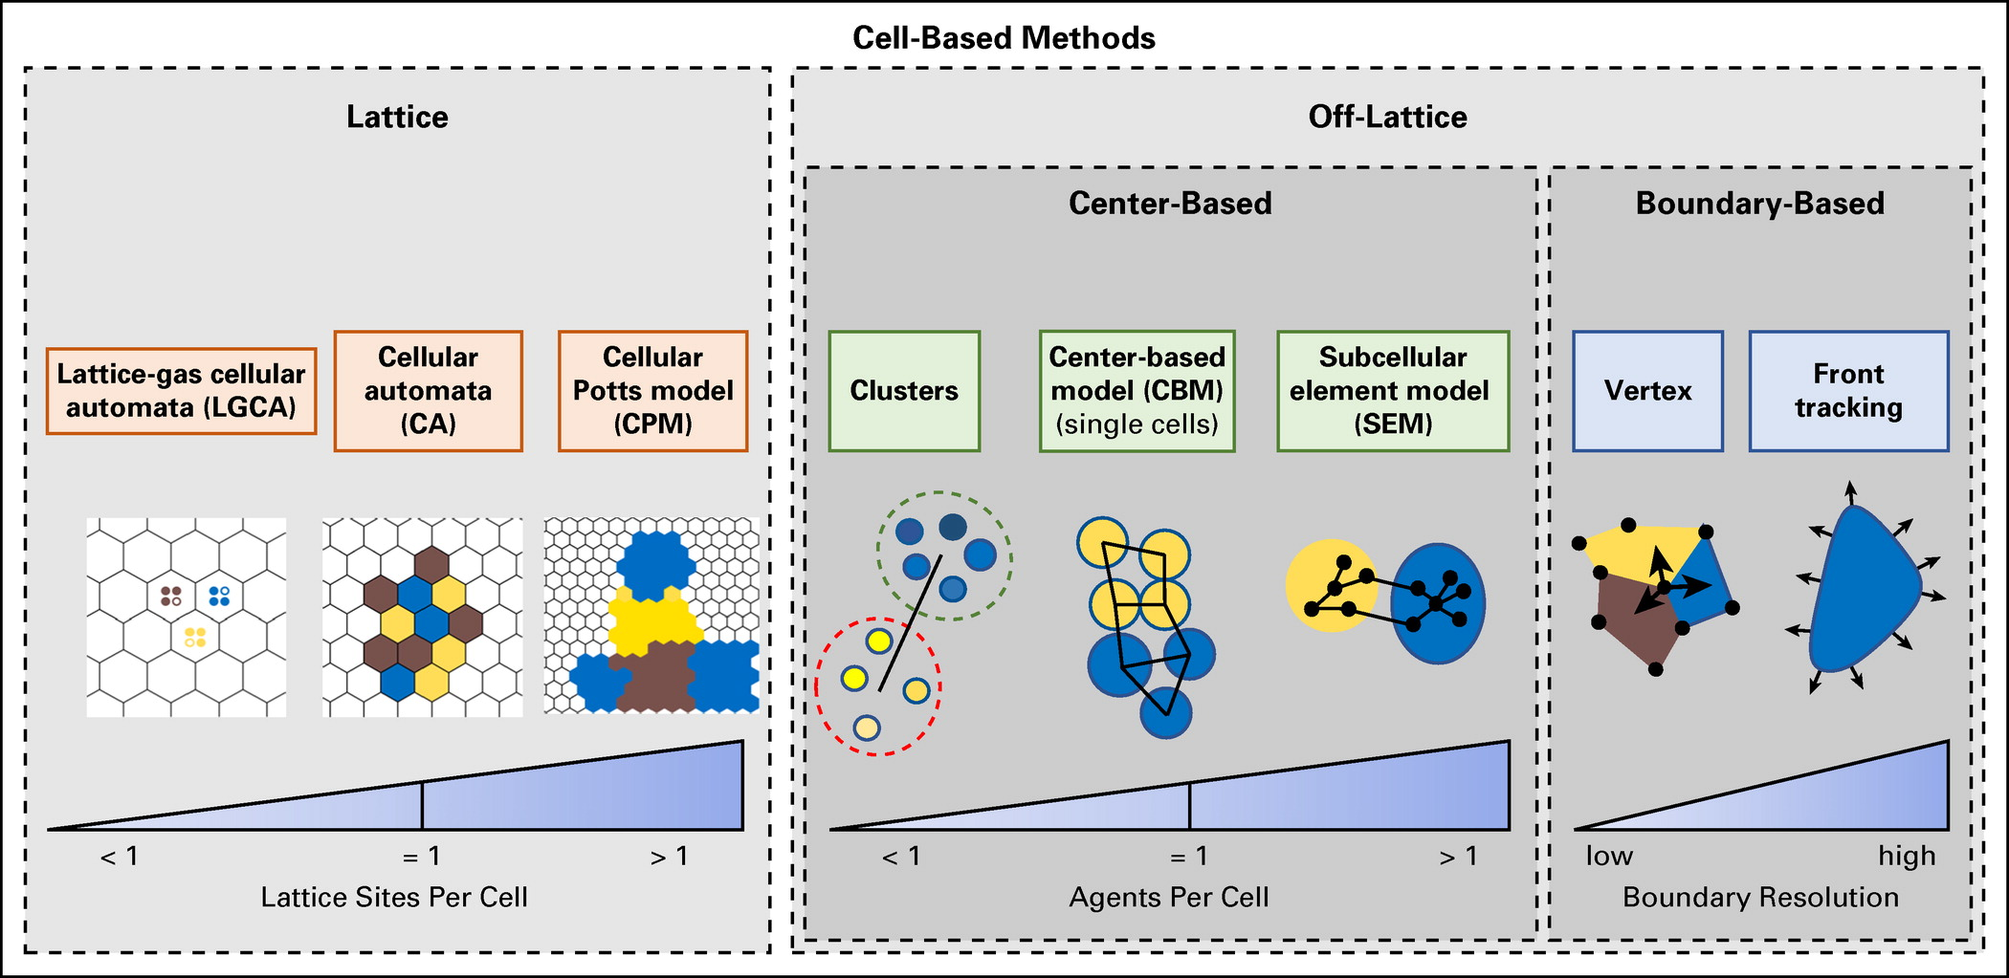
Main approaches
Approaches can be classified as lattice or off-lattice, and by resolution.
Review: Metzcar et al. (2019). http://dx.doi.org/10.1200/CCI.18.00069

Slide 11
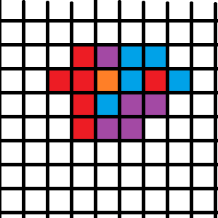
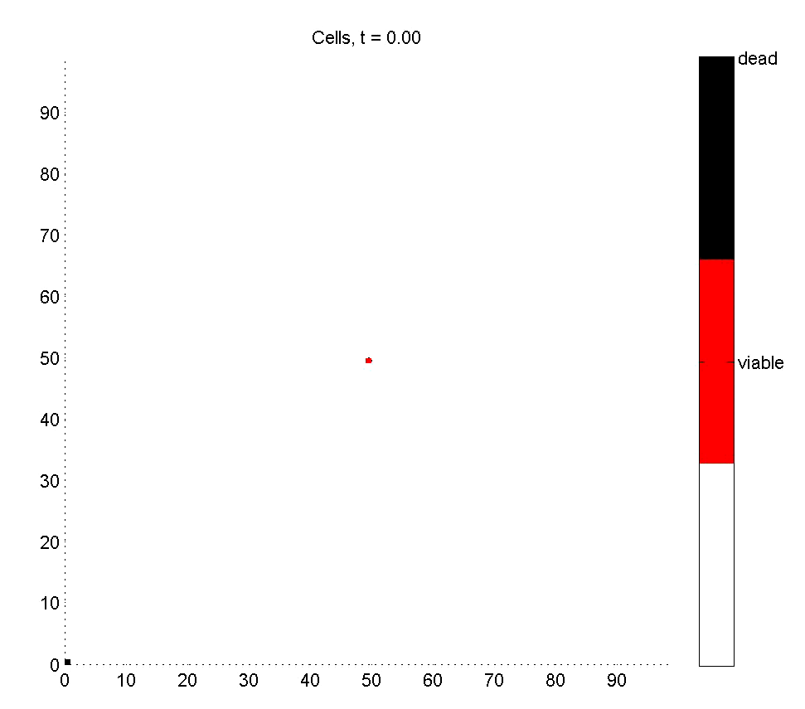
Cellular Automata
Approach:
Divide space into a lattice
Spatial resolution: Each lattice site holds 0 or 1 cell
Update each lattice site based on rules
Pros:
Easy to program
Very, very fast
Easy to swap in new hypotheses
Cons:
Lattice effects (& hidden assumptions)
All cells are the same size
No tissue mechanics
Update order biases
Usually solved with Monte Carlo (random update ordering)
Ideal use case:
Early qualitative tests of hypotheses

Slide 12
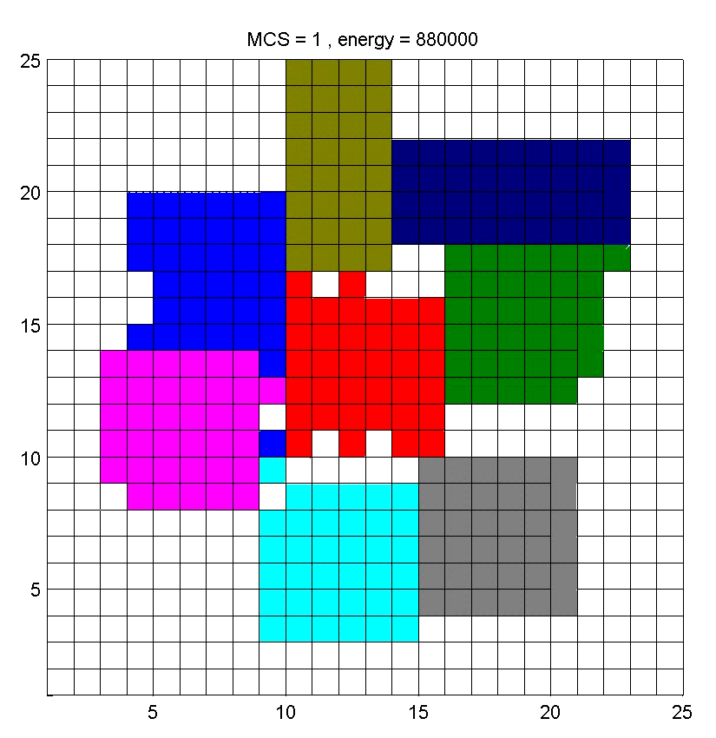
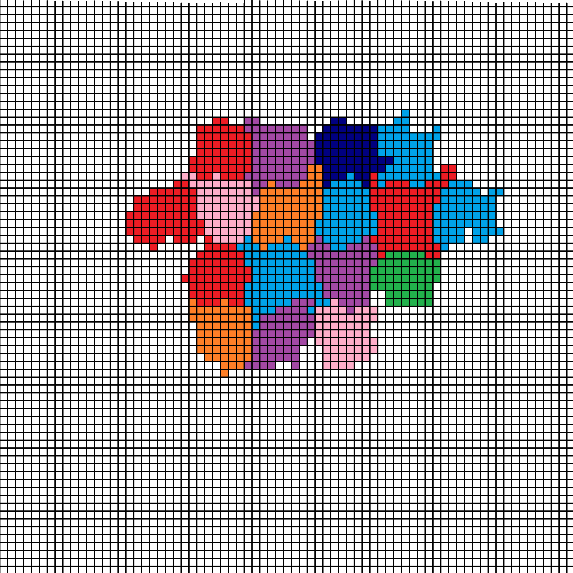
Cellular Potts
Approach:
Use a smaller mesh to resolve cell morphology
Spatial resolution: multiple pixels (or voxels) per cell
Minimize a specially-chosen energy
Randomly try to swap pixels
Accept if energy is lower
Pros:
Now we get cell shape and size
More realistic
Mature codes such as CompuCell3D and Morpheus
Cons:
No true time: Monte Carlo steps and “temperature”
Have to translate biology into energy
Unexpected correlations can pop up from the global energy
Needs expert coding to be fast
Ideal use case:
Qualitative tests of hypotheses where mechanics matter

Slide 13
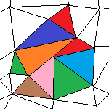
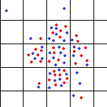
Other lattice-based approaches
Cellular automata on irregular meshes
Use an irregular mesh
Gets rid of grid bias issues
But still no control over individual cell sizes
Still no mechanics
Spatial resolution: One pixel (voxel) per cell
Lattice-gas
Treat space as a series of connected boxes
Each box contains one or more cells
Pre-defined “channels” for cell movement between boxes
A nice bridge towards continuum models
Spatial resolution: < 1 pixel (voxel) per cell

Slide 14
Key off-lattice approaches
Vertex-based models:
Densely packed cells look like polyhedral
Model the movement of the vertices, instead of the cells
Spatial resolution: 1 polyhedron per cell, approximating morphology
Center-based models:
Model movement of cell centers
Write force balance laws for each cell (classic physics!)
Update cell velocities and positions based on forces
Append extra biology to each cell as needed
Spatial resolution: 1 agent per cell
Subcellular element models:
Model movement of cell parts with individual agents (subcellular elements)
Write force balance laws for each part (classic physics!)
Update agent velocities and positions based on forces
Model cell growth, cycling, death, etc. with additional operations:
grow, divide, shrink, fuse, and eliminate subcellular elements
Spatial resolution: multiple agents per cell to approximate morphology

Slide 15
Typical ABM program flow
Read parameters
Set up microenvironment
Create meshes, initialize chemical substrates, diffusion solvers, etc.
Set up cell agents
Define all cell types
Instantiate cells
For each time:
Update microenvironment
Solve reaction-diffusion equations (as needed)
Solve tissue mechanics (as needed)
Update each cell's state
Sample environment
Run signaling model (as needed)
Update behavioral parameters based on signaling model and sampled environment
Run cell process models (growth, cycling, death, …)
Calculate cell velocities
Update cell positions
Advance time

Slide 16
Where does PhysiCell fit in?
PhysiCell is an off-lattice, center-based modeling platform
Spatial resolution: one agent per cell
A trick: Use bigger agents to model cell collections or pieces of tissue.
PhysiCell couples with PDE models of the microenvironment, making it a hybrid discrete-continuum approach.
Since most useful agent-based models are coupled to PDE models of the microenvironment, we simply refer to them as agent-based models.
PhysiCell uses ODEs and other technical to model dynamical details in individual cells. This makes it multiscale.

Slide 17
Key components of PhysiCell
BioFVM: simulate the (chemical) microenvironment (the stage)
chemical diffusion and decay
boundary conditions
cell-based secretion, uptake, and export
PhysiCell: simulate individual cell agents (the players)
live in a microenvironment
single-cell biological behaviors
cell functions model biological hypotheses to trigger core behaviors
cell-cell interactions

Slide 18
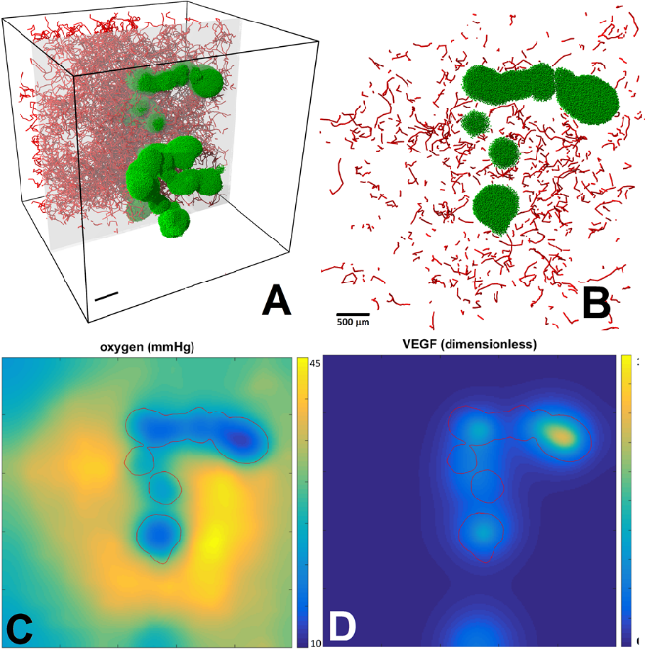
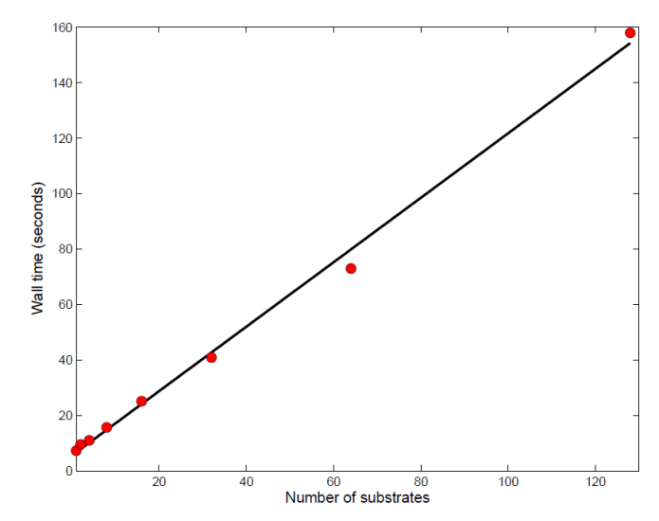
BioFVM: Simulating the 3-D microenvironment
Design goal: Simulate multiple diffusing substrates in 3D with desktops or single HTC/HPC nodes
Typical use: pO₂, glucose, metabolic waste, signaling factors, and a drug, on 10 mm³ at 20 µm resolution
Features:
Off-lattice cell secretion and uptake
2nd-order accurate (space), 1st-order accurate (time), numerically stable
Method:
Operator splitting, LOD, customized Thomas solvers, etc.
Standard C++11, cross-platform
OpenMP parallelization
O(n) cost scaling in # substrates, # voxels
Easy to simulate 5-10 substrates on 10⁶ voxels
Reference: Ghaffarizadeh et al., Bioinformatics (2016)
DOI: 10.1093/bioinformatics/btv730
Simulatoin time
1,000,000 voxels
Δx = 10 μm
Δt = 0.01 min
Simulate 2 minutes
# of substrates

Slide 19
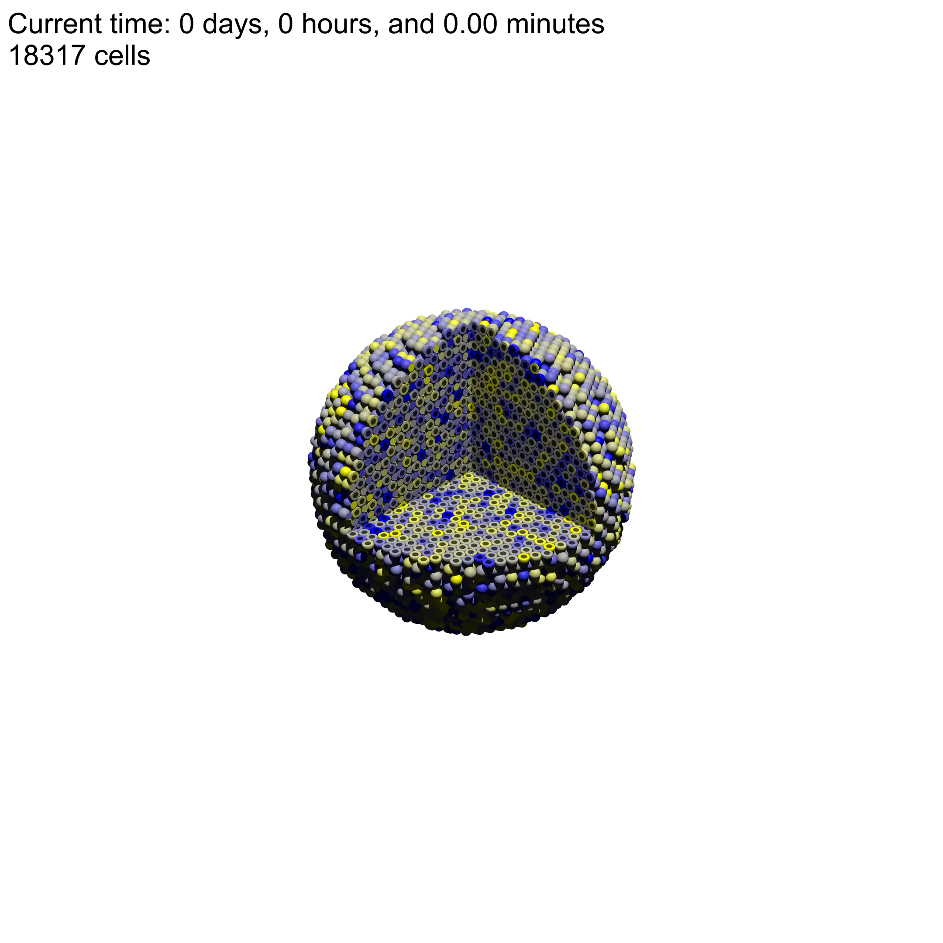


PhysiCell: A multicellular framework
Design goal: Simulate 10⁶ or more cells in 2D or 3D on desktops or single HPC nodes
Features:
Off-lattice cell positions
Mechanics-based cell movement
Cell processes (cycling, motility, …)
Signal-dependent phenotype
Can dynamically attach custom data and functions on a cell-by-cell basis
Deployed from Raspberry Pi to Crays
Method:
Standard C++11, cross-platform
OpenMP parallelization
O(n) cost scaling in # cells
Reference: Ghaffarizadeh et al., PLoS Comput. Biol. (2018)
DOI: 10.1371/journal.pcbi.1005991
2019 PLoS Computational Biology Research Prize for Public Impact
Try this model yourself!
nanohub.org/tools/pc4heterogen
Competition in a 3-D tumor
[View on YouTube (8K)]

Slide 20
Key parts of a PhysiCell model (1)
Microenvironment (stage):
diffusing substrates
diffusion coefficient
decay rate
boundary conditions
Defined in XML configuration file
Cell Definitions (types of players):
name
default phenotype (more on next page)
defined in XML configuration file

Slide 21
Key parts of a PhysiCell model (2)
Cell agents (individual players):
Which cell type? (the cell agent is initialized based on a cell definition)
State variables:
position
mechanical pressure
interaction list (optional)
Phenotype (the script)
Cell cycle
Volume
Death
Motility
Mechanics
Substrate uptake & release
Custom variables
Custom functions that act upon the phenotype, variables, and state (script)

Slide 22
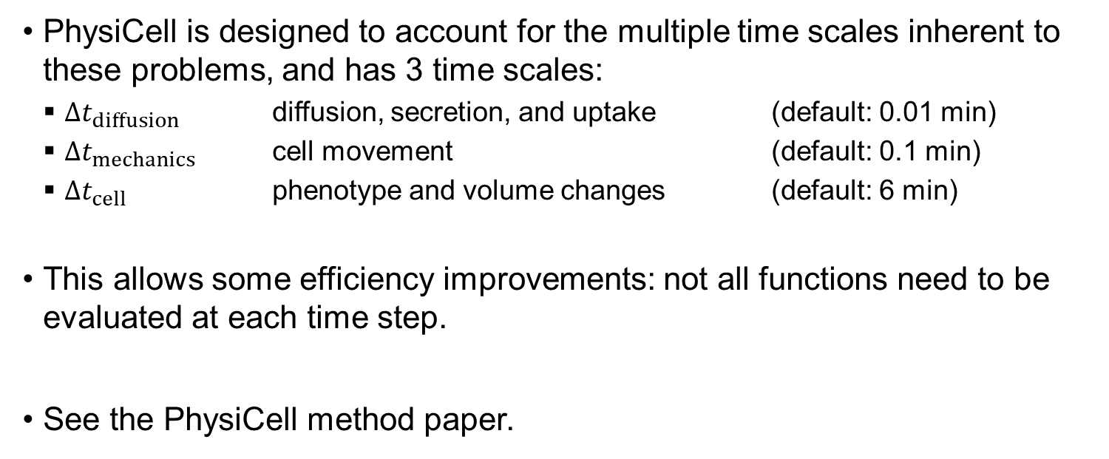
A note about time steps
PhysiCell is designed to account for the multiple time scales inherent to these problems, and has 3 time scales:
$Δt_{diffusion}$ diffusion, secretion, and uptake (default: 0.01 min)
$Δt_{mechanics}$ cell movement (default: 0.1 min)
$Δt_{cell}$ phenotype and volume changes (default: 6 min)
This allows some efficiency improvements: not all functions need to be evaluated at each time step.
See the PhysiCell method paper.

Slide 23
use some stanford slides
what is an agent-based model
players and the stage and script
type of discfete
physicell
focus on microeniorn
focus on playesr (agents)
focus on script (rules / models)
examples

Slide 25




Funding Acknowledgements
PhysiCell Development:
Breast Cancer Research Foundation
Jayne Koskinas Ted Giovanis Foundation for Health and Policy
National Cancer Institute (U01CA232137)
National Science Foundation (1720625)
Training Materials:
Administrative supplement to NCI U01CA232137 (Year 2)

